Slide 1
Consent for Recording this Call
Microsoft would like to record this call so that the recording may be shared with global call participants or others who were not able to attend today, including service providers, customers, partners, and others at Microsoft. The recording may include your voice, image, and/or chat comments. Do you agree?

Slide 2

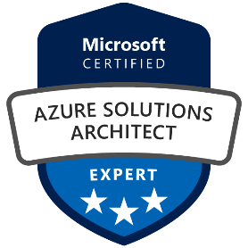
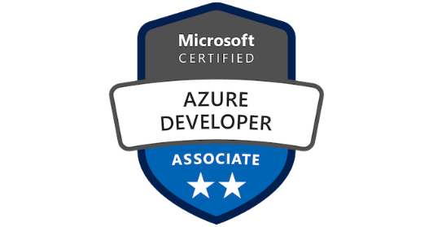
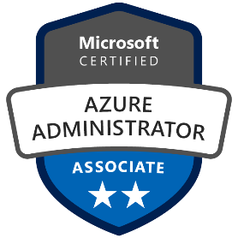
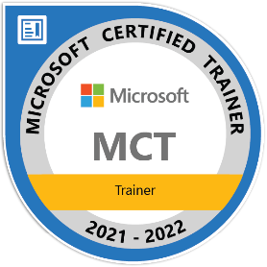
Meet our speaker
Rogerio Guimaraes
Cloud Native Solution Architect

Slide 3
Cloud Native Development

Slide 4
Cloud native architecture
Microservices
Architectural approach to developing an application as a collection of modular, loosely coupled services
DevOps
People, processes, and technology that promote collaborative building and delivery
Containers
Standard deployment format to abstract code from underlying infrastructure differences
APIs
Expose services as light-weight APIs for easier integration
Functions
Event driven compute-on-demand experience that extends with capabilities to implement code triggered by events

Slide 6
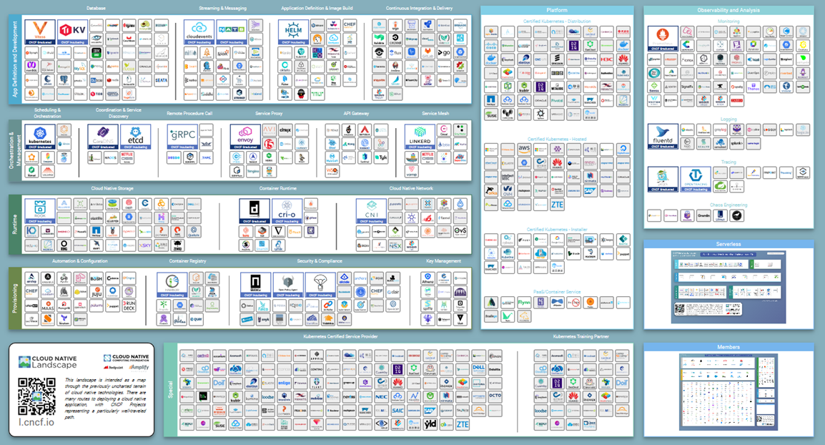
The landscape and the technologies that support CND are complex and diverse

Slide 7
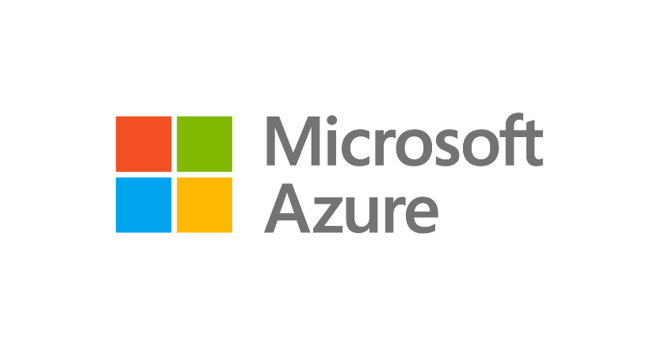
Cloud native application development
Cloud native architecture
AI powered UI and application logic
Integration using connectors and API management
Fully managed
data
Software delivery using DevOps practices
Operations - as automated as possible
Multi-layered security

Slide 8

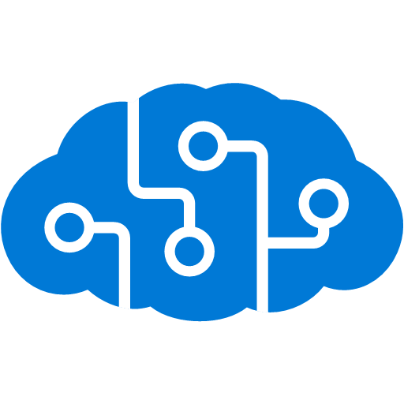





Cloud native architecture on Azure
Azure API Management
Azure Kubernetes Service (AKS)
Azure Cognitive Services
Azure Container Instances
Microservices
GitHub
Azure Cosmos DB
Azure Functions
Azure Database for PostgreSQL
Azure Arc
On-premises
Edge
Multi-clouds

Slide 9

Demo

Slide 10
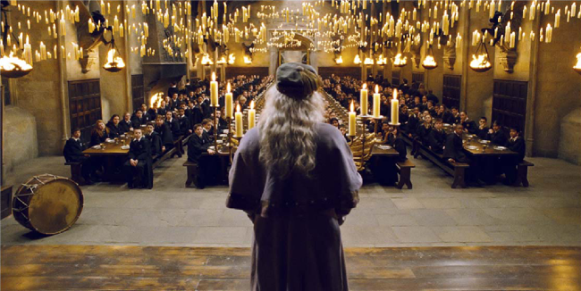
USE CASE – Hogwarts Data Privacy Dept
Share information about Hogwarts citizens who get vaccinated for Covid-19
Easy to Access
Cost Effective
Easy to Maintain
New Technologies
Cloud Native

Slide 11









Product Manager
Developer
API Manager
Developer
Azure Kubernetes Service
Azure API Management
Azure Functions
Azure CosmosDB
Observability

Slide 12

That’s all Folks

